Slide 1
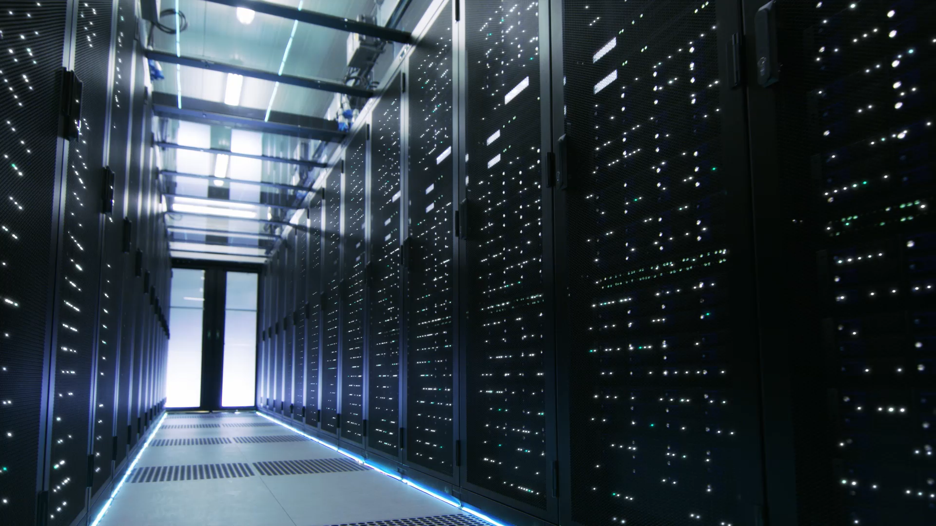
The Spatial Analysis Behind Data Center Development in Northeastern Illinois
Kelly McFadden, GISP, MS
HBK Engineering

Slide 2
Presentation Outline
What is a data center?
Why Northeastern Illinois?
Where in Northeastern Illinois?
What impact do data centers have on communities?
Questions/Comments?

Slide 3
What is a data center?
Definition
Fiber optics role
Increased demand

Slide 4
Data Center Definition and Functions
Compute
Store
Network
Physical Facilities that house computing machines and related hardware
(AWS; IBM; Palo Alto Networks)
Notes:
AWS; Cisco; IBM; Palo Alto Networks;

Slide 5


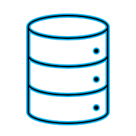

Fiber Enabled Data Centers
(Computer History Museum; Digital Realty)

Slide 6
Increased Data Center Demand
Past
e-commerce
Content Delivery Networks
Present
Cloud computing
Future
Quantum Computing
(Generative) Artificial Intelligence
(Tsoneva & Affleck, 2024; Vanderbilt, 2009)
Notes:
Butler, 2025;

Slide 7
Current Data Center Growth
Current global value: $100-$200 billion
Project 2035 value: $200-$600 billion
Led by Fortune 500 companies
(Vaden & Humphries, 2024)
Notes:
Goldman Sachs; Zoting, 2025

Slide 8
Why Northeastern Illinois?
Resources
Electricity
Fiber
Water
Available real estate
Skilled labor
Tax incentives

Slide 9
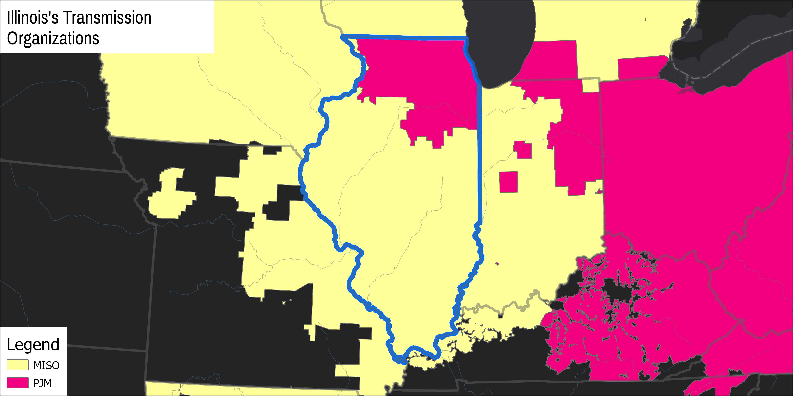
(Federal Energy Regulatory Commission; Illinois Power Agency; Manson, et al., 2024; Oak Ridge National Laboratory, 2024)

Slide 10
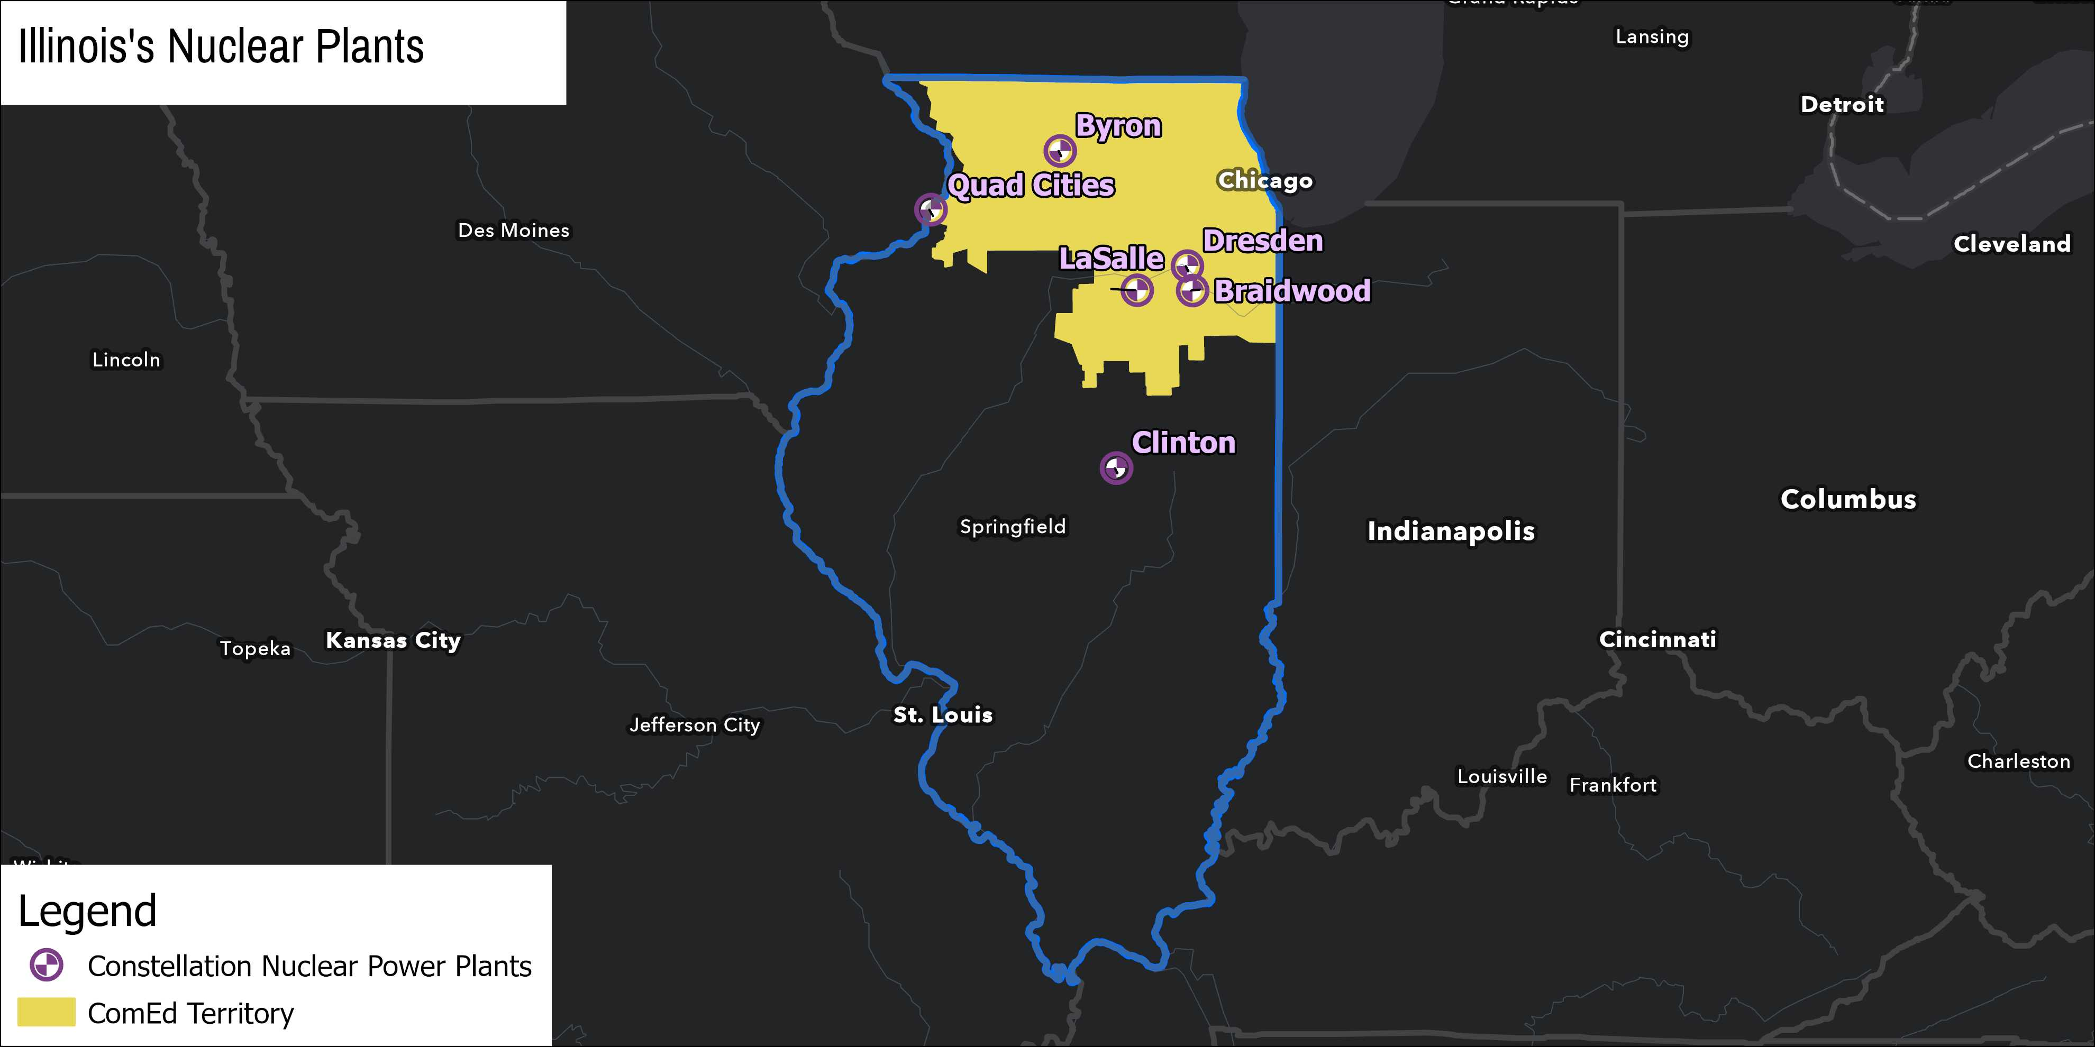
(Illinois Power Agency; Manson, et al., 2024; U.S. Energy Information Administration, 2025; Oak Ridge National Laboratory, 2022)

Slide 11
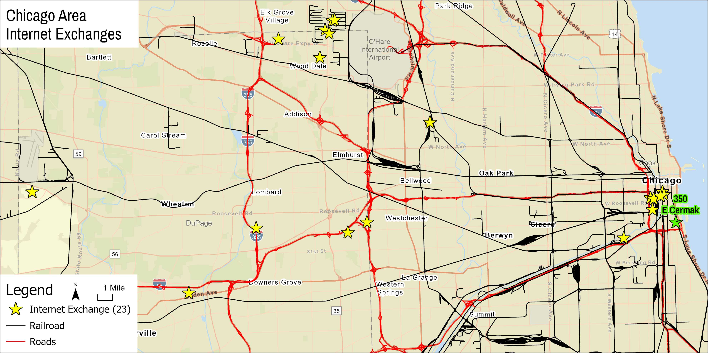
(Illinois Department of Transportation, 2023; 2021; Newby Ventures, 2023; Sonnemaker, 2019; Vanderbilt, 2009)

Slide 12
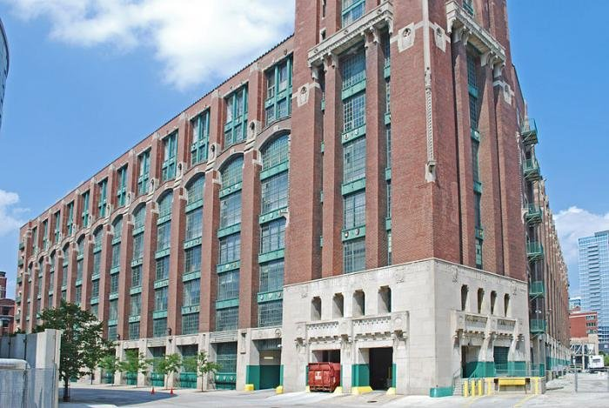
350 E Cermak
(Sonnemaker, 2019; Vanderbilt, 2009)

Slide 13
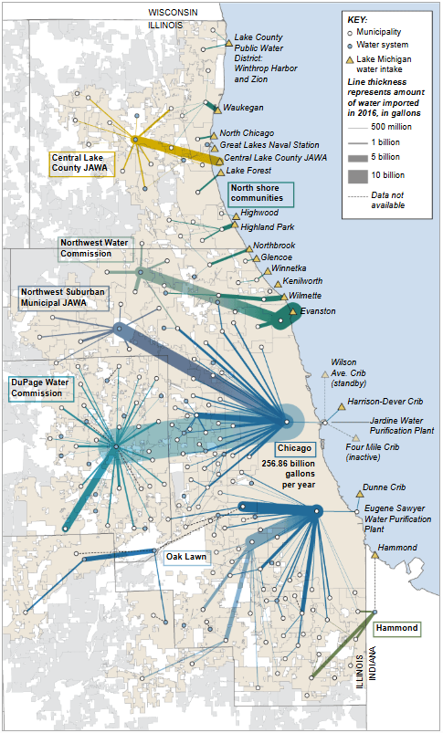
Northeastern Illinois’s Water Resources
(Chicago Tribune; Maco, 2021)

Slide 14
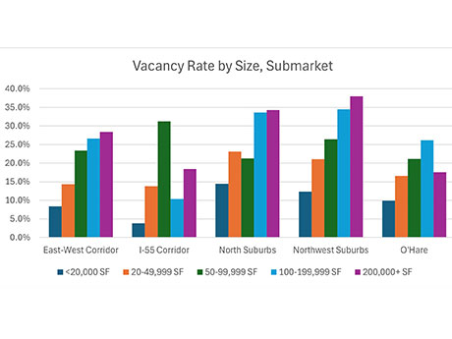
Real estate
(Johnson, 2024)
Notes:
Johnson, 2024; Peterson, 2023

Slide 15
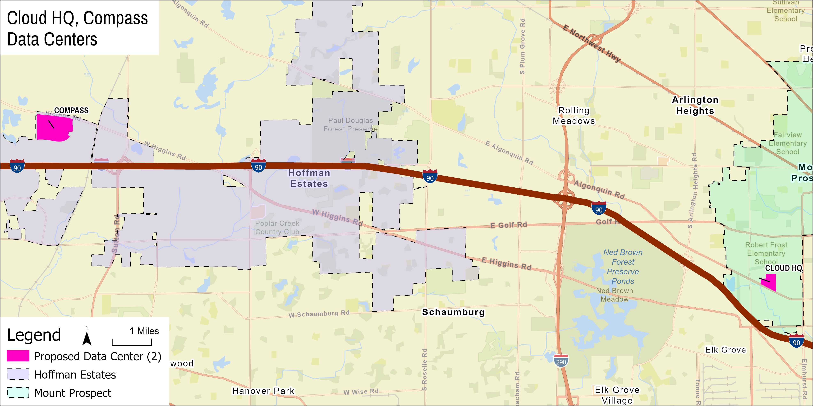
(Cook County, 2016; Cullota, 2022; Data Center Map; DataCenters.com, 2025; ESRI, 2025; Peterson, 2023)

Slide 16
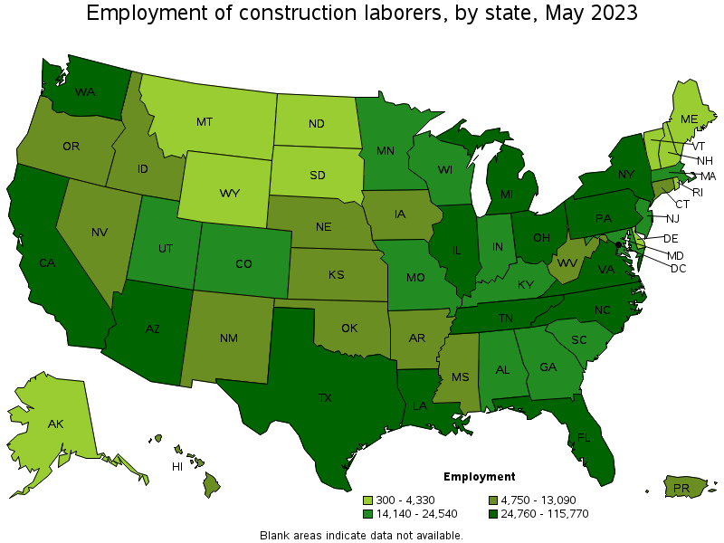
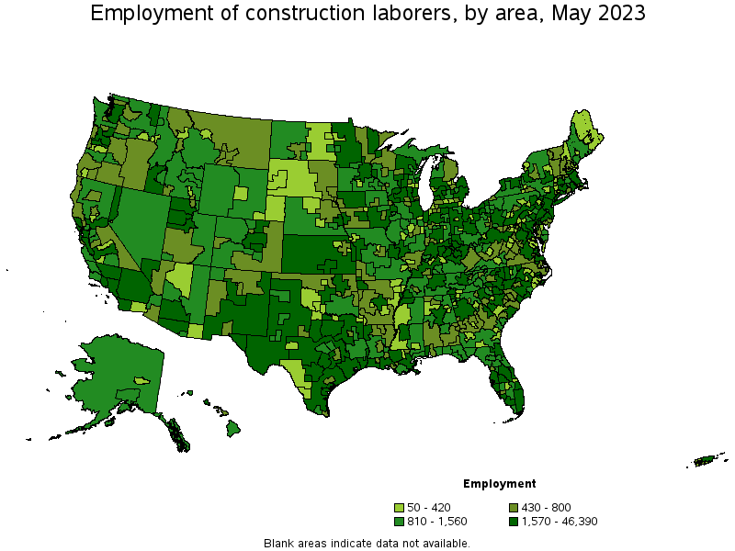
(Peterson, 2024; U.S. Bureau of Labor Statistics, 2023; Zawislack, 2024)

Slide 17
Illinois Tax Incentives for Data centers
Criteria
At least $250 million over 60 months
20 fair-wage, full-time jobs
Operate at Carbon Neutral
Exemptions
Sales and use tax
20% of construction wage taxes
(Illinois Department of Commerce & Economic Opportunity; Marotti, 2019; Peterson, 2025)

Slide 18
Why Northeastern Illinois?
Resources
Electricity
Fiber
Water
Available real estate
Skilled labor
Tax incentives

Slide 19
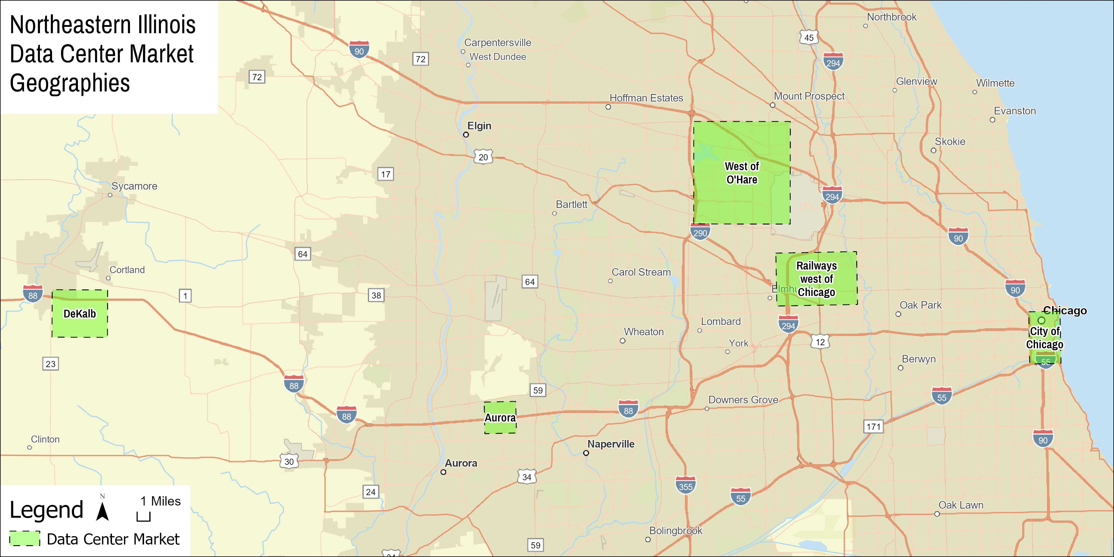

Slide 20
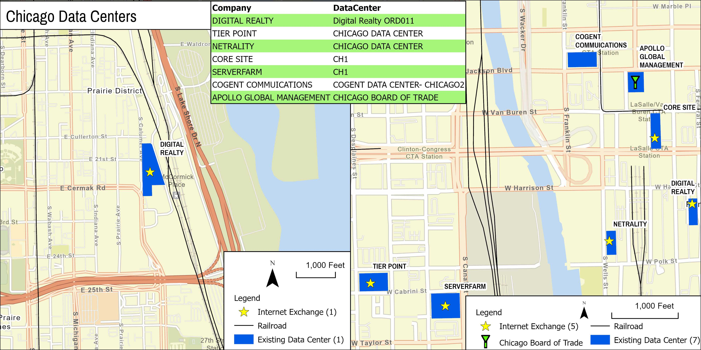
(Data Center Map; DataCenters.com, 2025; Illinois Department of Transportation, 2021; Newby Ventures; Peltz, 2013; 2012; Woodward, 2019)

Slide 21
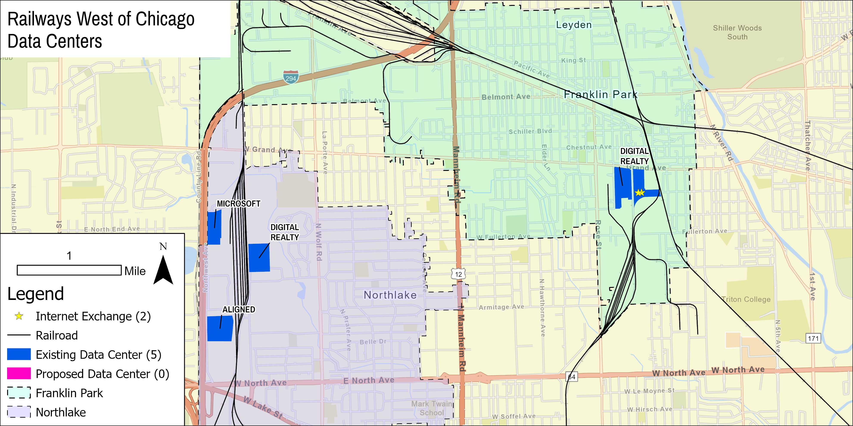
(Anonymous, 2012; 2010; Burns, 2009; Cook County, 2016; Data Center Map; DataCenters.com, 2025; Illinois Department of Transportation, 2021; Luc, 2022 ; Newby Ventures)

Slide 22
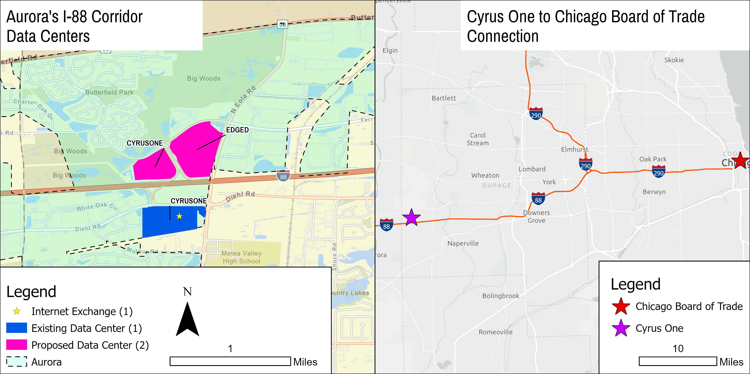
(Cook County, 2016; Data Center Map; DataCenters.com, 2025; ESRI, 2025; Lord 2024a; 2024b; 2024c; Newby Ventures)
Notes:
Lord 9/19/24; 6/16/24; 10/4/24; Smith, 3/2/2025

Slide 23
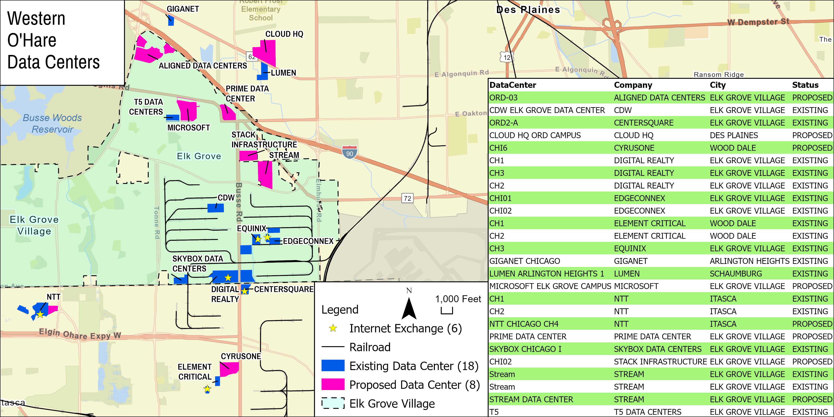
(Cook County, 2016; Data Center Map; DataCenters.com, 2025; Illinois Department of Transportation, 2021; Newby Ventures; Placek, 2025; 2019; Village of Elk Grove, 2023)
Notes:
Placek, 2025-4-11; 2019-10-25

Slide 24
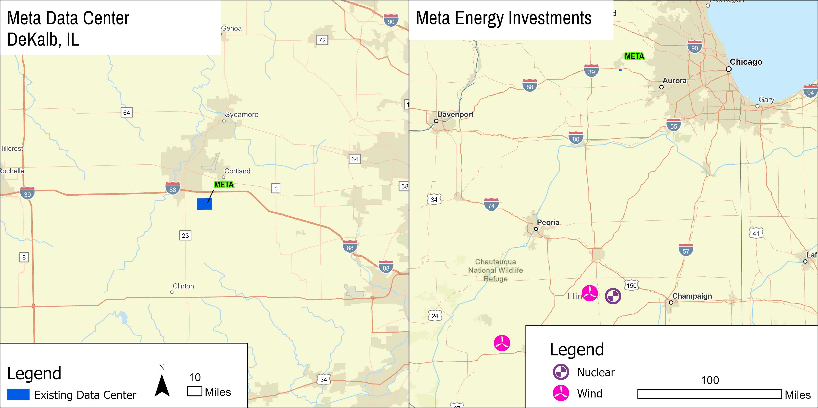
(Bertram, 2022; Channick, 2023a; 2023b; 2022; Data Center Map; DataCenters.com; Smart Energy Decisions; 2021; Stock, 2023; U.S. Energy Information Administration, 2025; Wade, 2025)

Slide 26
What impact do data centers have on communities?
Positive
Negative

Slide 27
Positive Data Center Impacts
Infrastructure enhancements
Increased construction activities
Real estate revitalization
Increased tax revenue
(Channick, 2023a; Lippert, 2025; Luc, 2022; Markstein, 2018; Peltz, 2025; Placek, 2019; Village of Mount Prospect, 2023; Zalusky, 2023)

Slide 28
Increased Construction Activities tied to
Building materials
Heavy machinery operations
Logistics
Financial services

Slide 29
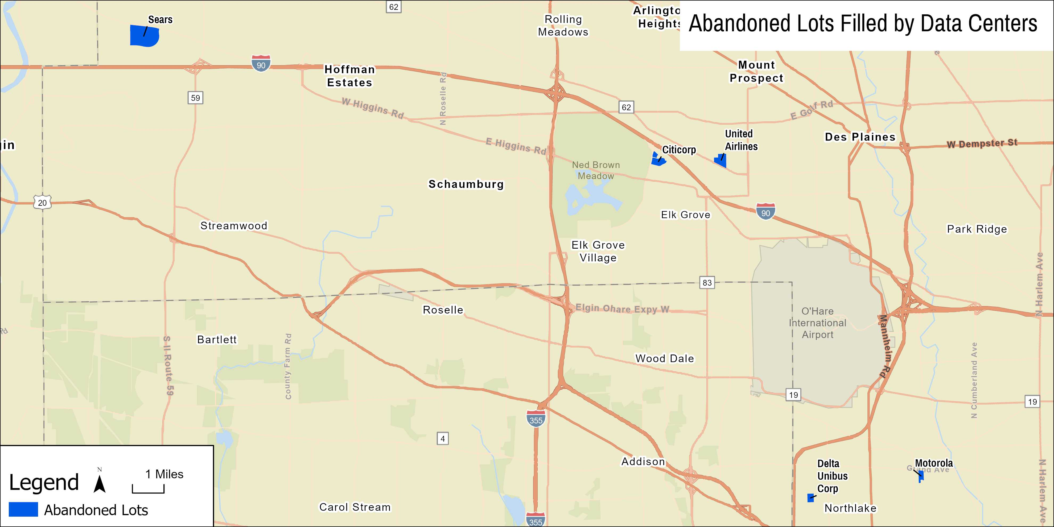

Slide 30
Increased tax revenue
Farmland
Abandoned lot
Data
Center

Slide 31
Negative Data Center Impacts
Resource strain
Increased utility rates
Disrupt clean energy transition
(Atkins, 2024; Channick, 2023b; Chase & Gearino, 2025; Johnson, 2025; Lippert, 2025; Luc, 2022; Markstein, 2018; Miller, 2024; Peltz, 2025; Placek, 2019; Schoenberg, 2024; Village of Mount Prospect, 2023; Wade, 2025; Zalusky, 2023)

Slide 32
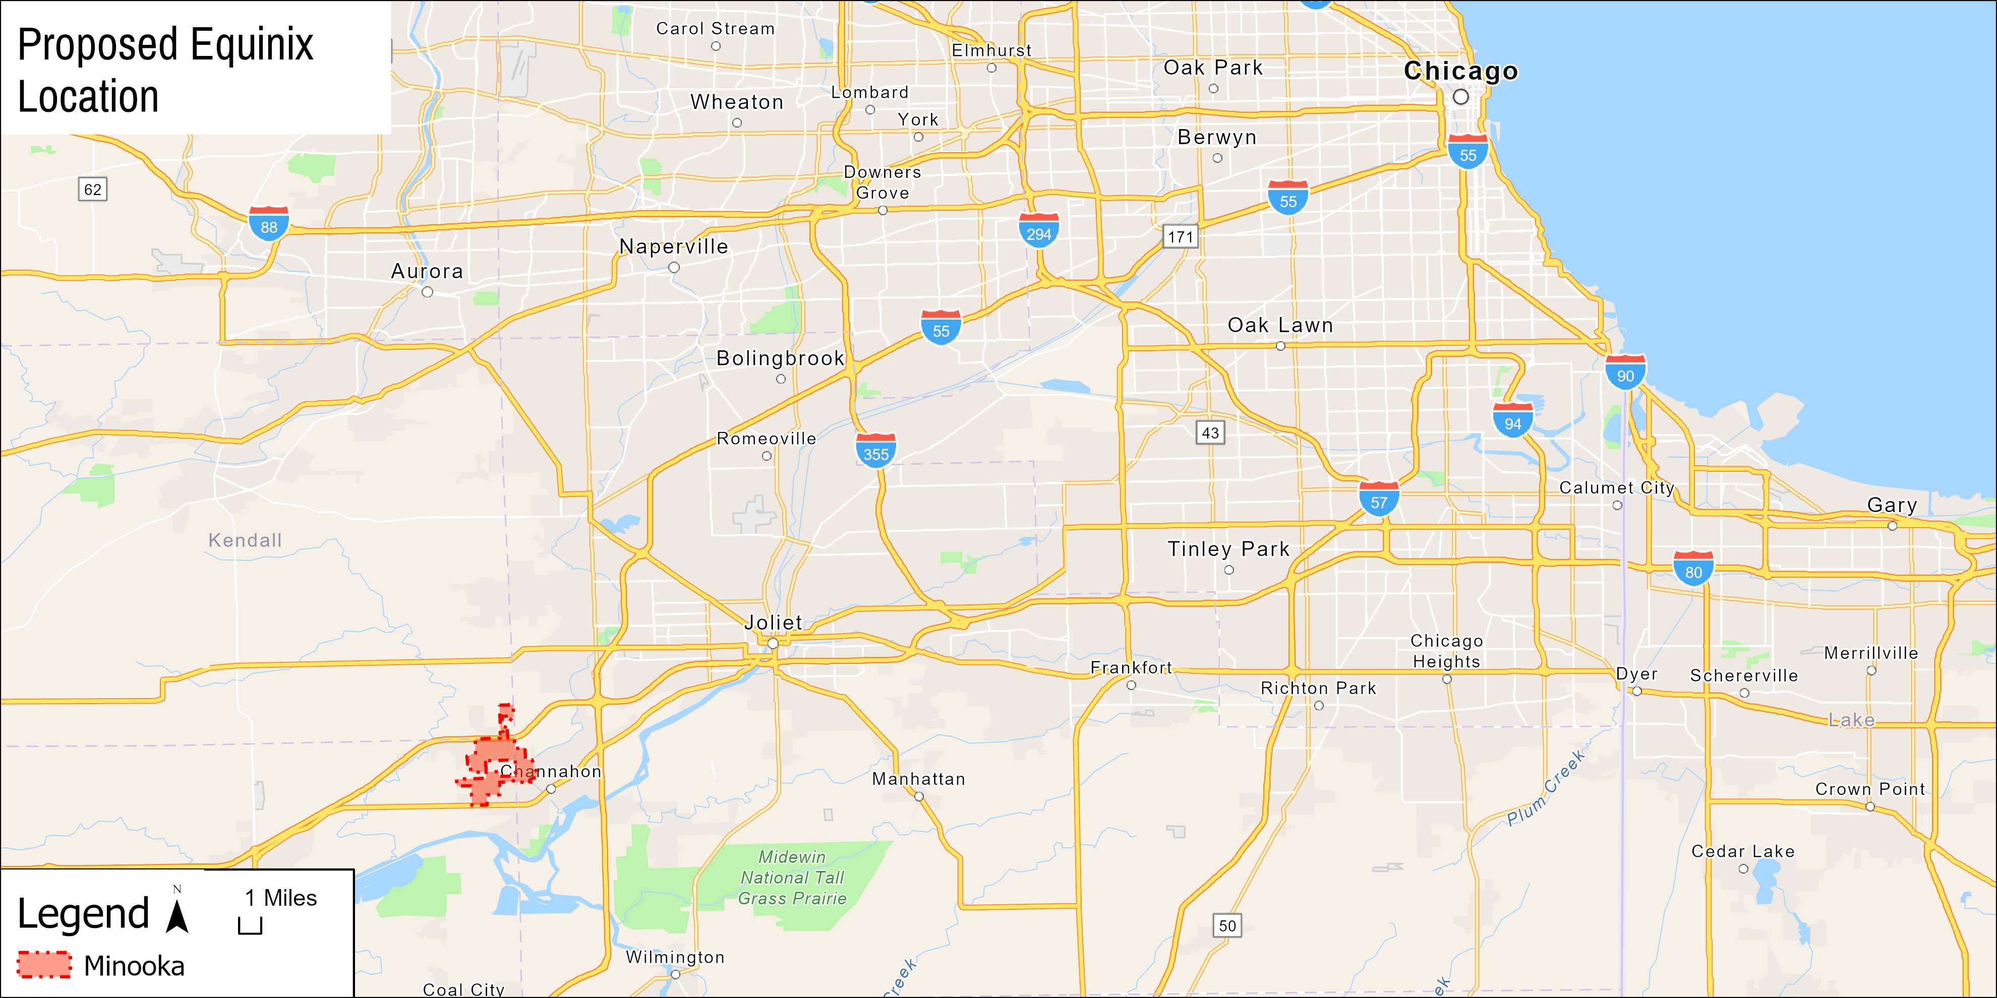

Slide 33
More Data Centers =
Higher utility rates
Increased coal dependence
Renewed reliance on nuclear

Slide 34
What impact do data centers have on communities?
Positive
Negative

Slide 35
Presentation Outline
What is a data center?
Why Northeastern Illinois?
Where in Northeastern Illinois?
What impact do data centers have on communities?
Questions/Comments?

Slide 36
Presentation Outline
What is a data center?
Why Northeastern Illinois?
Where in Northeastern Illinois?
What impact do data centers have on communities?
Questions/Comments?

Slide 37
References
Atkins, K. (2024, November 17). Nuclear plants in Illinois are caught in the crosshairs: Data centers, AI push for more clean power as old, new hurdles exist. Chicago Tribune.
anonymous. (2010, December 9). chicago breaking business.com. Chicago Tribune.
anonymous. (2012, June 7). EXECUTIVE SUMMARY. Chicago Tribune. AWS. (n.d.). What is a data center. AWS. Retrieved June 15, 2025, from https://aws.amazon.com/what-is/data-center/
Bertram, S. (2022, May 5). The Center Square: Illinois - Franklin News Foundation: State and local tax incentives part of Meta expansion in DeKalb. The Center Square: Illinois.

Slide 38
References
Burns, G. (2009, October 12). Microsoft predicting “cloud” burst: Computing center in Chicago area one of few in world -- for now. Chicago Tribune.
Channick, R. (2022, April 29). ComEd carbon credit to lower bills by $20 per month in June: A dividend from bailout of 3 struggling Illinois nuclear plants. Chicago Tribune, 5.
Channick, R. (2023a, September 3). A changing suburban corporate landscape: Headquarters give way to data and logistics centers post-pandemic. Chicago Tribune.
Channick, R. (2023b, November 30). Meta turns on the power for $1B DeKalb data center. Chicago Tribune, 1.
Chase, B., & Gearino, D. (2024, November 22). ComEd electric bills to go up more than $10 a month. Here’s why. [News]. Chicago Sun Times. https://chicago.suntimes.com/the-watchdogs/2024/11/22/comed-electric-bills-quantum-computing-data-centers-ai-pritzker-pjm-cub

Slide 39
References
Computer History Museum. (n.d.). Mainframe Computers [Education]. Computer History. Retrieved June 21, 2025, from https://www.computerhistory.org/revolution/mainframe-computers/7
Cook County. (2016). Municipality [API]. https://gis.cookcountyil.gov/traditional/rest/services/politicalBoundary/MapServer
Cullotta, K. A. (2022, September 20). With new $2.5B site, data centers booming in Illinois: Work gets underway on campus at former United Airlines HQ. Chicago Tribune, 5.
Data Center Map. (n.d.). Chicago Data Centers. Retrieved June 21, 2025, from https://www.datacentermap.com/usa/illinois/chicago/
DataCenters.com. (2025). Chicago Data Centers Locations. https://www.datacenters.com/locations/united-states/illinois/chicago

Slide 40
References
Digital Realty. (n.d.). A Brief History of Data Centers. Retrieved June 15, 2025, from https://www.digitalrealty.com/resources/articles/a-brief-history-of-data-centers
ESRI. (2025). USA_Freeway_System [GIS data; Feature service]. https://www.arcgis.com/home/item.html?id=91c6a5f6410b4991ab0db1d7c26daacb
Federal Energy Regulatory Commission. (n.d.). Electric Power Markets [Education]. FERC. https://www.ferc.gov/electric-power-markets
The Fiber Optic Association. (2022). FOA Fiber Optic Timeline [Blog]. The FOA. https://www.thefoa.org/Timeline/index.html
IBM. (n.d.). What is a data center? IBM. Retrieved June 15, 2025, from https://www.ibm.com/think/topics/data-centers

Slide 41
References
Illinois Department of Commerce & Economic Opportunity. (n.d.). Data Center Investment Tax Exemptions and Credits. DECO. https://dceo.illinois.gov/expandrelocate/incentives/datacenters.html
Illinois Department of Transportation. (2021). Illinois Railroads [GIS data; Shapefile]. https://gis-idot.opendata.arcgis.com/datasets/illinois-railroads/explore
Illinois Department of Transportation. (2023). Illinois Jurisdiction [GIS data; Shapefile]. https://gis-idot.opendata.arcgis.com/datasets/IDOT::illinois-jurisdiction/explore?showTable=true
Illinois Power Agency. (n.d.). Electricity Generation Mix [Education]. Clean Energy Illinois. https://cleanenergy.illinois.gov/tracking-illinois-progress/electricity-generation-mix.html
Johnson, M. (2025, May 19). ComEd customers will see a rate increase beginning June 1. How much, and why is it happening? [News]. WGN TV. https://wgntv.com/news/comed-customers-will-see-a-rate-increase-beginning-june-1-how-much-and-why-is-it-happening/

Slide 42
References
Johnson, A. (2024, October 17). Multi-Tenant Trophy Buildings Shine in Chicago Office Market [Market research]. Rebusiness Online. https://rebusinessonline.com/multi-tenant-trophy-buildings-shine-in-chicago-office-market/
Lippert, J. (2025, May 23). Weighing environmental tradeoffs: Landing a data center is worth the ecological impact, Illinois towns say. Chicago Tribune.
Lord, S. (2024a, February 16). Aurora to negotiate with data center: Change in zoning could allow company to build on 30-acre site. Chicago Tribune,
Lord, S. (2024b, June 19). Aurora to negotiate with data center: Change in zoning could allow company to build on 30-acre site. Chicago Tribune.
Lord, S. (2024c, October 4). AURORA: Construction of $350M Cyrus One data center to begin. Chicago Tribune, 1.

Slide 43
References
Luc, K. A. (2022, November 14). ComEd, Digital Realty mark expansion of data center in Franklin Park with opening of new power substation. Daily Herald.
Manson, S., Schroeder, J., Van Riper, D., Katherine, K., Kugler, T., Roberts, R., & Ruggles, S. (2024). IPUMS National Historical Geographic Information System: Version 19.0 [U.S. State 2020] (Version 19) [GIS data; Shapefile]. https://doi.org/http://doi.org/10.18128/D050.V19.0
Markstein, B. (2018, September 14). The Importance of Construction to State Economies [News]. ABC. https://www.abc.org/News-Media/News-Releases/the-importance-of-construction-to-state-economies
Marotti, A. (2019, June 5). Data center boosters hope tax incentives “stop the bleeding”: Plan is to keep tech sites in Illinois with equipment exemptions. Chicago Tribune.
Miller, A. (2024, December 13). Growth of Chicago area data centers taking off with no signs of a slowdown [News]. Chicago Sun Times. https://chicago.suntimes.com/real-estate/2024/12/13/growth-chicago-area-data-centers-taking-off-no-signs-slowdown

Slide 44
References
Newby Ventures. (2023, February). Meet Me in Chicago [Data]. Newby Ventures. https://www.newby-ventures.com/research/meet-me-series/meet-me-in-chicago/
Oak Ridge National Laboratory. (2024). Independent Systems Operators [GIS data; Shapefile]. Homeland Infrastructure Foundation Level Database (HIFLD). https://gii.dhs.gov/HIFLD
Oak Ridge National Laboratory, Los Alamos National Laboratory, Idaho National Laboratory, & National Geospatial-Intelligence Agency Homeland Security Infrastructure Program Team. (2022). Electric Retail Service Territories [GIS data].
Palo Alto Networks. (n.d.). What is a data center? Palo Alto Networks. Retrieved June 15, 2025, from https://www.paloaltonetworks.com/cyberpedia/what-is-a-data-center
Peltz, J. (2025, January 30). Clayco sees revenue soar from data center projects: The Chicago-based construction company saw revenue from data center projects more than double last year. Chicago Tribune.

Slide 45
References
Peltz, J. (2013, January 21). Chicago: A digital life preserver. Crain’s Chicago Business, 36(3).
Peltz, J. (2012, September 17). WIRED. Crain’s Chicago Business, 35(38), 9.
Peterson, E. (2025, June 5). Suburbs welcoming data centers say they will benefit communities. Daily Herald.
Peterson, E. (2024, February 4). A time of change Office: Suburban market softens at the end of. Chicago Tribune.
Peterson, E. (2023, September 3). Data center firm on track to buy Sears campus. Then what? Daily Herald.

Slide 46
References
Placek, C. (2019, October 25). Full TextNewspaper New ComEd substation primes Elk Grove Village for data center. Daily Herald.
Placek, C. (2025, April 11). Elk Grove mayor touts data centers as cash cows for local. Daily Herald.
Schoenberg, N. (2024, October 20). Illinois struggling on climate projections: Clean energy not meeting targets as projects face hurdles. Chicago Tribune.
Smart Energy Decisions. (2021, November 23). Meta and McDonald’s PPAs Facilitate Illinois Wind Farm. https://www.smartenergydecisions.com/news/meta-and-mcdonalds-ppas-facilitate-illinois-wind-farm/
Sonnemaker, T. (2019, February 19). Traffic never jams at Chicago’s busiest internet intersection [News]. Meddill Northwestern University. https://news.medill.northwestern.edu/chicago/traffic-never-jams-at-chicagos-busiest-internet-intersection/

Slide 47
References
Stock, E. (2023, June 30). DeWitt County wind farm that helps power Meta goes online [News]. WGLT. https://www.wglt.org/local-news/2023-06-30/dewitt-county-wind-farm-that-helps-power-meta-goes-online
Tsoneva, T., & Afflek, J. (2024, July 17). Decoding Data Centers: Opportunities, risks and investment strategies [Market Research]. CBRE Investment Research. https://www.cbreim.com/insights/articles/decoding-data-centers
U.S. Bureau of Labor Statistics. (2023, May). Occupational Employment and Wages, May 2023 [Government]. Occupational Employment and Wage Statistics. https://www.bls.gov/oes/2023/may/oes472061.htm
U.S. Energy Information Administration. (2025). Power Plants [GIS data]. https://services7.arcgis.com/FGr1D95XCGALKXqM/arcgis/rest/services/Power_Plants_Testing/FeatureServer
Vaden, H., & Humphreys, S. (2024, April 25). Data demand: US power sector responds to AI-driven growth (No. 141) [Audio recording].

Slide 48
References
Vanderbilt, T. (2009, June 8). Data Center Overload. New York Times Magazine. https://www.nytimes.com/2009/06/14/magazine/14search-t.html
Village of Elk Grove. (2023, July 20). Elk Grove Village Designated Top Business Park Ranking by. Daily Herald.
Village of Mount Prospect. (2023). 6.5 Motion to authorize changes to the Village of Mount Prospect/Michael J. Cassady Village Manager Employment Agreement. https://docs.mountprospect.org/WebLink/DocView.aspx?id=2080817&dbid=0&repo=VOMP&cr=1
Wade, W. (2025, June 5). Illinois power to fuel AI demand: Meta signs 20-year deal to receive energy from nuclear plant in Clinton as tech firm’s consumption triples over four years. Chicago Tribune.
Woodward, A. (2019). Chicago Board of Trade. In Encyclopedia.com. https://www.encyclopedia.com/books/politics-and-business-magazines/chicago-board-trade

Slide 49
References
Zalusky, S. (2023, January 14). Utility tax hike targets data center complex. Daily Herald.
Zawislack, M. (2024, June 6). “Unprecedented demand” Data: Centers in demand Proposed. Daily Herald.

